Slide 1

Student Details
Name: SAALE RAVI
SKILLBUILD Email ID: RAVI93467666@GMAIL.COM
COLLEGE NAME: ST PETERS ENGINEERING COLLEGE,HYDERABAD
COLLEGE STATE: TELANGANA
INTERNSHIP DOMAIN: CYBER SECURITY
START AND END DATE: (13-10-2023 TO 26-11-2023)

Slide 2
HIDING MESSAGE IN AN IMAGE (STAGANOGRAPHY)

Slide 3

ONLINE BANKING BASED ON STEGNOGRAPHY
In the ever-evolving landscape of digital transactions and financial technologies, the security of online banking systems is of paramount importance. As financial institutions continually strive to enhance the confidentiality and integrity of customer data, innovative approaches are explored to fortify the protection of sensitive information during electronic transactions.
Steganography, an ancient art of concealing information within seemingly innocuous carriers, has found application in various domains, including digital communication. This project delves into the exploration of integrating steganography into the realm of online banking, aiming to assess its potential benefits and challenges.

Slide 4

AGENDA
Steganography is the art of hiding secret data in plain sight. It sounds kind of counter-intuitive, but you’d be surprised how effective it is.
Hiding things such as source code, passwords, IP addresses, and other confidential information in pictures, music, or other random files tends to be the last place anyone would think of finding them.
The primary goal of steganography is to embed secret data within seemingly innocuous files or communication channels. This can include hiding information in images, audio files, video files, or even text.

Slide 5
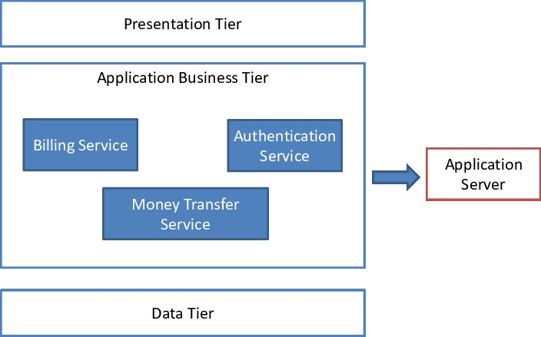
PROJECT OVERVIEW
In response to the ever-increasing need for robust security measures in online banking, this project explores the integration of steganography as an additional layer of protection. Steganography, the art of concealing information within seemingly innocuous carriers, offers a unique approach to fortifying the confidentiality and integrity of online banking transactions.
Objectives:
Enhancing Data Confidentiality: Investigate how steganography can be employed to conceal transaction-related data, adding an extra layer of security to sensitive financial information.
Exploring Feasibility: Assess the technical feasibility of integrating steganography into existing online banking systems without compromising performance, user experience, or introducing vulnerabilities.
Ethical Considerations: Scrutinize the ethical implications associated with the application of steganography in online banking, emphasizing transparency, user consent, and adherence to legal standards.
Technical Implementation: Assess the technical feasibility of integrating steganographic techniques into existing online banking infrastructures without compromising system integrity or user experience.

Slide 6

WHO ARE THE END USERS of this project?
The concept of "Online Banking Based on Steganography" involves several stakeholders, each playing a distinct role in the online banking ecosystem. Here are the potential end users and stakeholders:
Bank Customers
Financial Institutions
System Administrators
Regulatory Authorities
Cybersecurity Professionals
Technology Providers
Auditors and Compliance Officers
It's crucial to note that the integration of steganography in online banking raises ethical, legal, and security concerns. The involvement of various stakeholders is necessary to address these concerns and ensure a secure and compliant implementation. Transparency and communication with end users are also critical to maintaining trust in the online banking system.

Slide 7
YOUR SOLUTION AND ITS VALUE PROPOSITION
SOLUTION FOR ONLINE BANKING BASED ON STEGANOGRAPHY
Secure Bank StegoGuard is an advanced security solution designed to enhance the confidentiality and integrity of online banking transactions through the integration of steganography. By concealing transaction-related data within seemingly innocuous digital carriers, StegoGuard adds an extra layer of protection to sensitive financial information.
Steganographic Transaction Encryption
Dynamic Carrier Selection
User-Friendly Interface
Real-time Threat Monitoring
Regulatory Compliance
PROPOSITION OF ONLINE BANKING BASED ON STEGANOGRAPHY
It's important to note that the implementation of steganography in online banking must be approached with a thorough risk assessment, ethical considerations, and compliance with relevant laws and regulations. This solution is presented hypothetically and should be subject to rigorous testing and validation before real-world deployment.
Enhanced Data Confidentiality
Advanced Security Measures
User Trust and Confidence
Comprehensive Compliance
Innovation in Online Banking Security

Slide 8
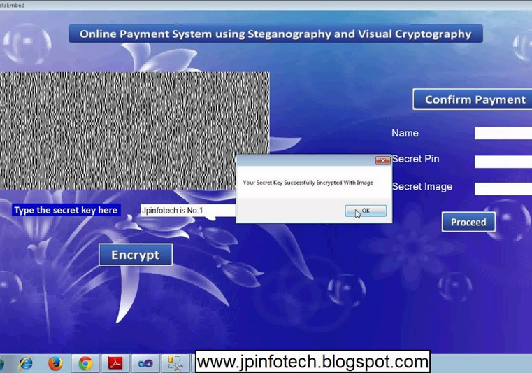
How did you customize the project and make it your own
In creating a hypothetical project for "Online Banking Based on Steganography," the customization can be tailored to meet specific objectives, considerations, and preferences. Here are some aspects you might consider customizing:
Objectives and Focus
Technical Details
Ethical and Legal Considerations
Security Measures
User Experience
Value Proposition
Compliance with Industry Standards
Testing and Validation

Slide 9
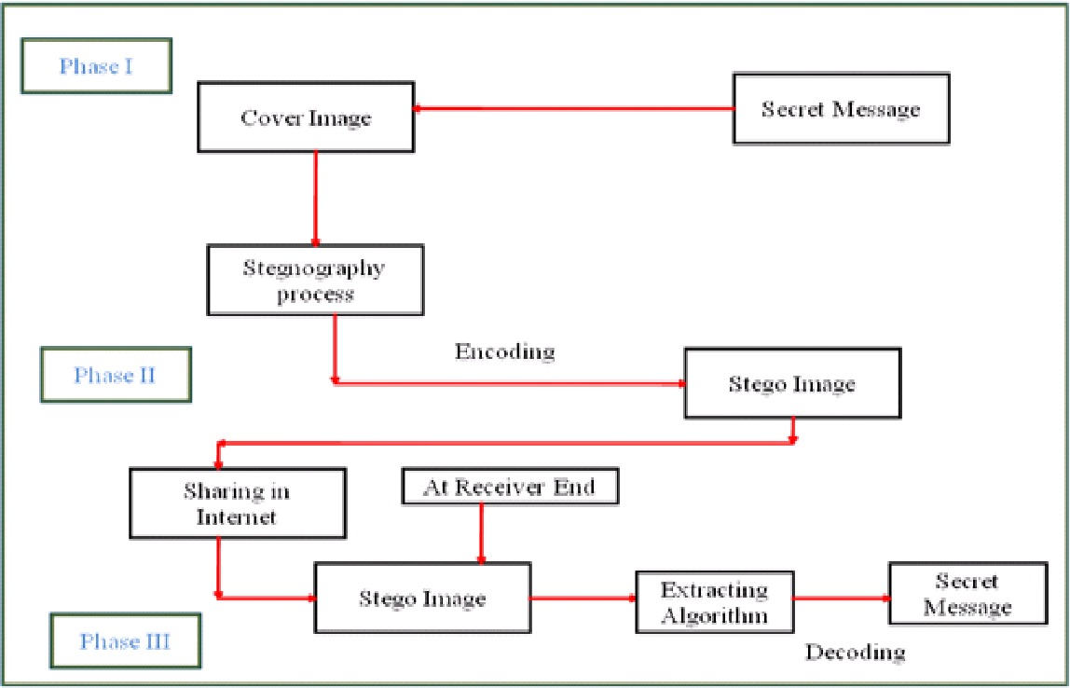
MODELLING
Modeling a system for online banking based on steganography involves defining the key components, interactions, and processes that make up the solution. Below is a simplified outline of how you might approach the modeling of such a system. Please note that this is a conceptual model, and the actual implementation would require detailed technical specifications and considerations:
User Interface (UI)
Transaction Module
Steganographic Engine
Encryption Module
Communication Layer
Authentication and Authorization
Backend Server
Database

Slide 10
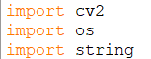
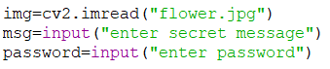
Project overview :- Hiding message in an image
Hiding message in an image :-
import cv2 :- It is used to import the OpenCV library. OpenCV (Open Source Computer Vision Library) is an open-source computer vision and machine learning software library. It provides various tools and functions that allow developers to work with images and videos, perform image processing tasks, computer vision applications, and more.
import os :- It is versatile and can be used for various file and directory-related operations in a platform-independent manner.
Here, img is equal to flower.jpg file and that can be read by using cv2.imread.

Slide 11
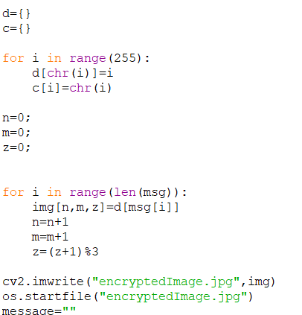
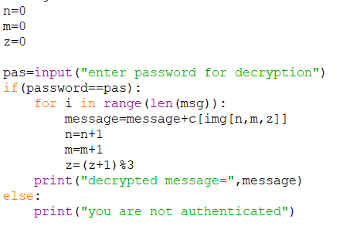
Encrypted image :- Encryption is the process of transforming information (plaintext) into a different format (ciphertext) using a specific algorithm and a secret key. The purpose of encryption is to ensure confidentiality, making the original information unreadable to unauthorized users.
Decrypted message :-
In steganography, after retrieving a steganographically hidden message from an image, you would typically need to decrypt the message if it was encrypted before being embedded.
It decrypts the entered message after encryption of image is done.

Slide 12
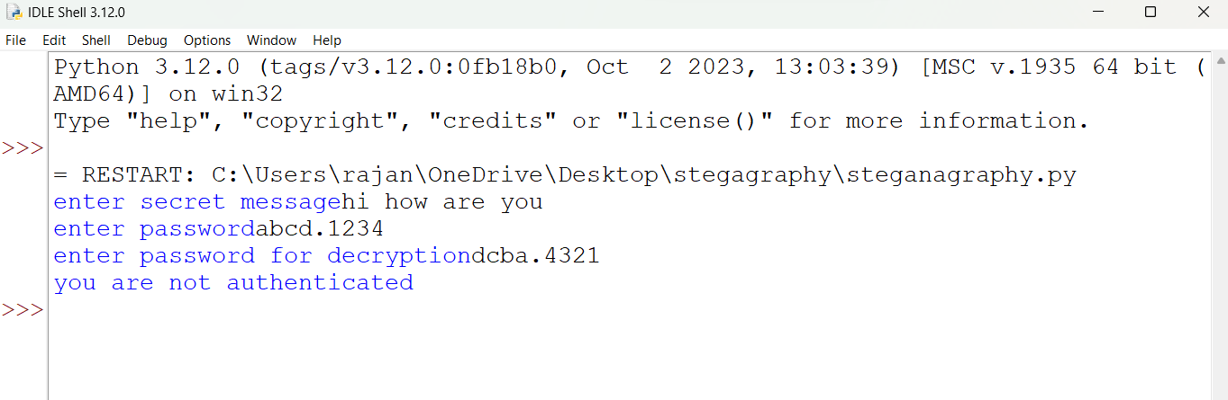
RESULTS

Slide 13


Flower Image Encrypted Flower Image

Slide 14
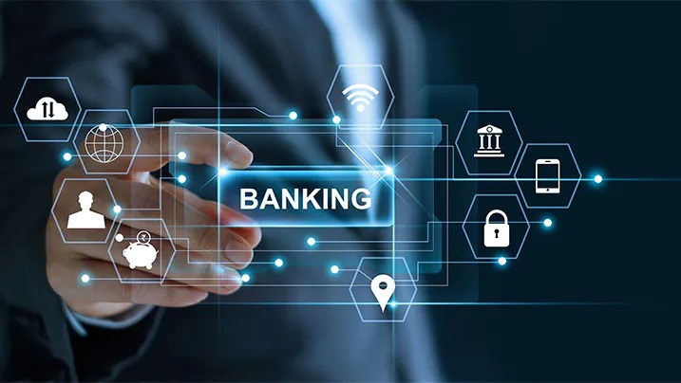
Results
The results of an online banking project can vary based on the goals, features, and implementation of the project. Here are some potential positive outcomes or results for an online banking system:
Convenience: Users can conveniently access their bank accounts, check balances, and perform transactions from anywhere with internet connectivity.
Efficiency: Online banking systems streamline financial processes, reducing the need for physical paperwork and manual transactions.
24/7 Accessibility: Users have 24/7 access to their accounts, allowing them to check balances, transfer funds, and pay bills at any time.
Transaction History: Users can easily view and track their transaction history, making it simpler to manage finances.
Alerts and Notifications: Automated alerts and notifications keep users informed about account activities, helping to prevent fraud or unauthorized transactions.
Security Measures: Implementation of robust security measures, such as encryption, two-factor authentication, and secure communication protocols, ensures the safety of user information.

Slide 15
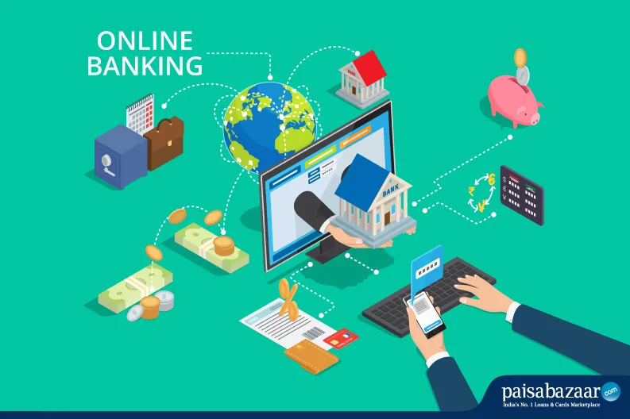
Bill Payment Services: Online banking often includes features for paying bills electronically, saving time and effort for users.
Mobile Banking: Many online banking systems offer mobile apps, providing additional flexibility and convenience for users on the go.
User-Friendly Interface: A user-friendly interface enhances the overall user experience, making it easy for customers to navigate and use the online banking platform.
Cost-Effective: Online banking reduces the need for physical infrastructure, paperwork, and manual processing, resulting in cost savings for both banks and customers.
Improved Customer Service: Online banking platforms often integrate customer support features, allowing users to get assistance or information without visiting a physical branch.
It's important to note that the success of an online banking project is also contingent on effective security measures to protect users' sensitive information and financial transactions. The implementation should comply with regulatory standards and industry best practices to ensure the integrity and security of the online banking system.

Slide 16
links
https://drive.google.com/file/d/1gb-cdJb6Dc-zti11M9QVdEmTfX0irzQM/view?usp=drivesdk
https://drive.google.com/file/d/1er28ACuTCPVC7WXCI1zCfYpSE_zfi76g/view?usp=drivesdk

